Slide 1

Final Project
Santiago Calvillo

Slide 2



Project: Travel Browser
Search for museums, cities and art pieces across the globe
Faceted search for art pieces
Ability to create personal plans
Ability to write reviews on museums
See analytics of the database

Slide 3

Demo Walkthrough

Slide 4
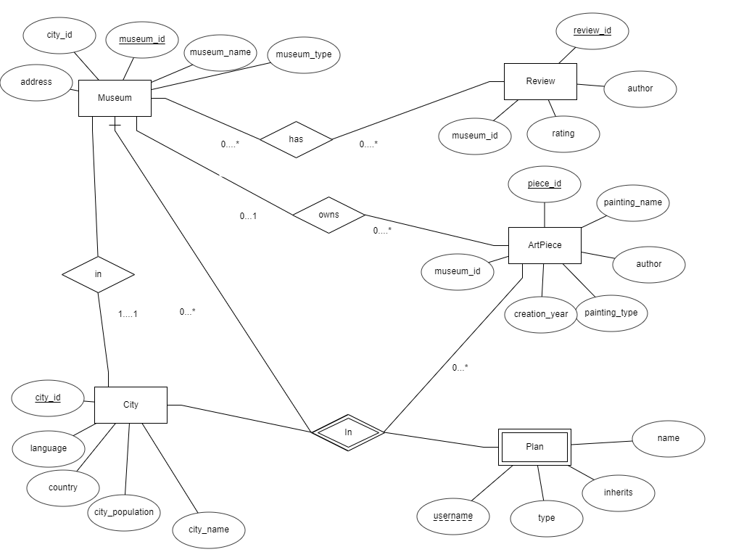
ER diagram

Slide 5
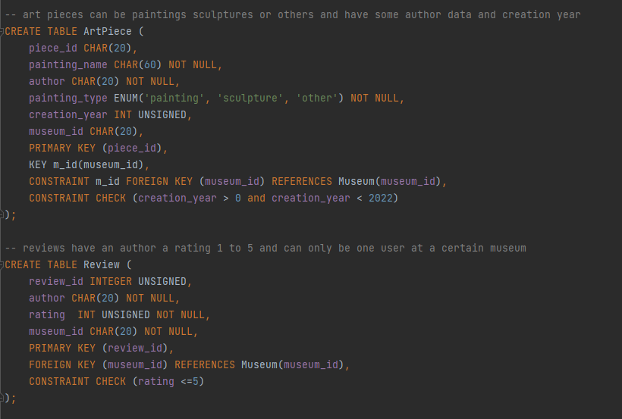
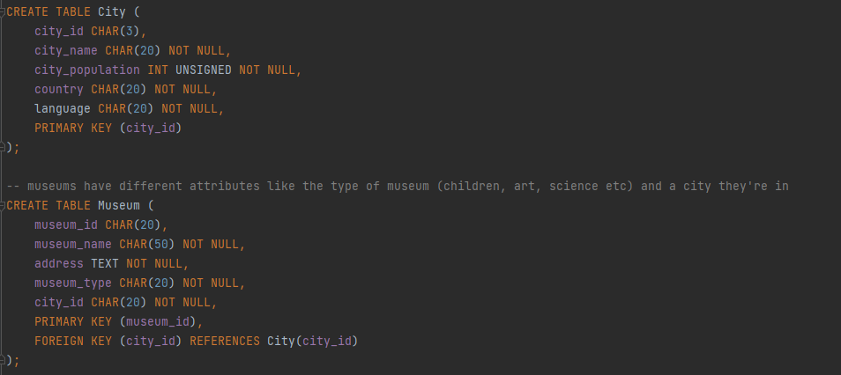
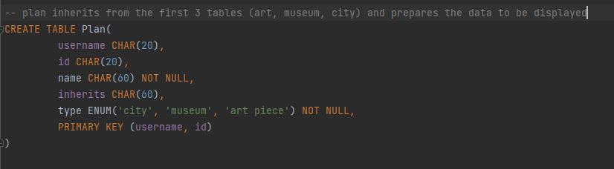
Tables

Slide 6
Queries
Most popular cities
Top museums by best review average
Museums with the most 5 star reviews

Slide 7
How it was tested

Slide 8


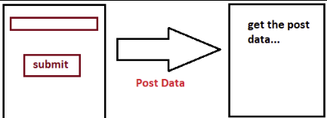
Challenges
User verification
Not familiar with php
Sending post data

Slide 9
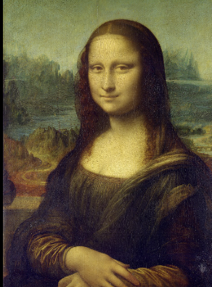


Future improvements
Image support
Better UI
Security in users

